Slide 1
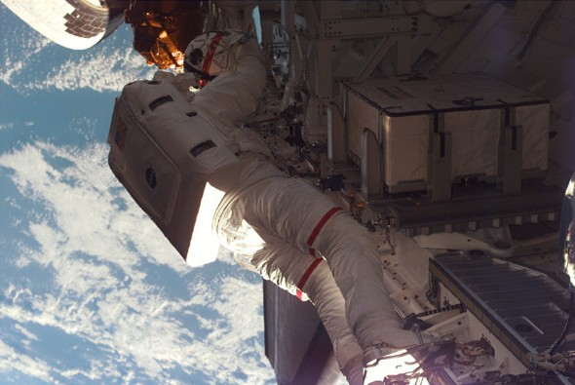
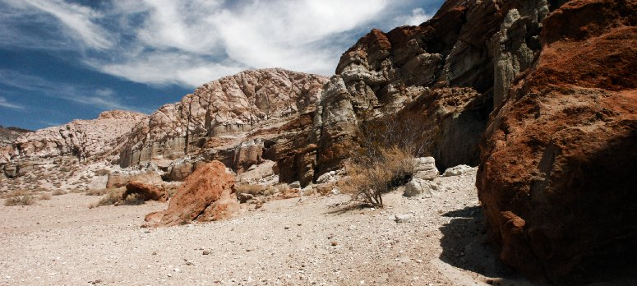
Histogram
bright
？

Slide 2
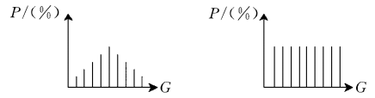

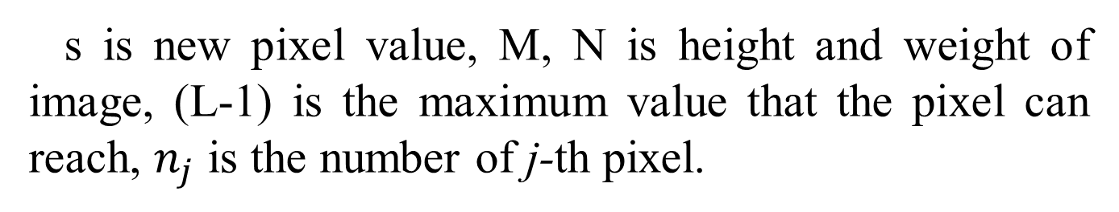
Method
$$s=\left(L−1\right)\sum_{j=0}^{k}{p_{r}\left(r_{j}\right)}=\left(L−1\right)\sum_{j=0}^{k}{\frac{n_{j}}{MN}=\frac{L−1}{MN}\sum_{j=0}^{k}{n_{j}}}$$
HE
s is new pixel value, M, N is height and weight of image, (L-1) is the maximum value that the pixel can reach, $n_{j}$ is the number of j-th pixel.

Slide 3
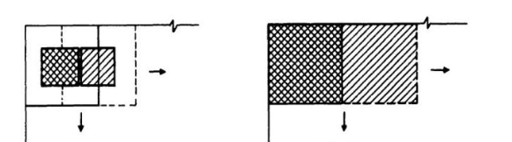
Method
AHE
middle
first, I am calculating the circle around the image. And on the boundary, I'm going to do a mirror padding. So when I'm dealing with the middle part, there's not a lot to think about.

Slide 4
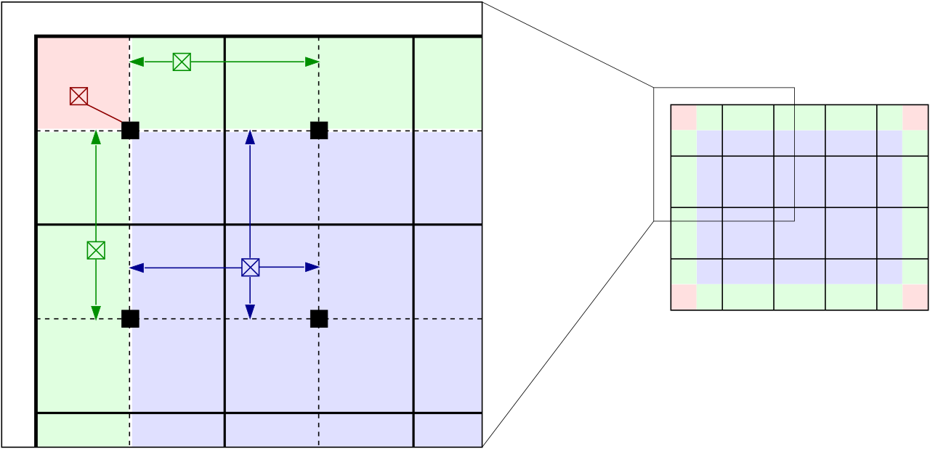
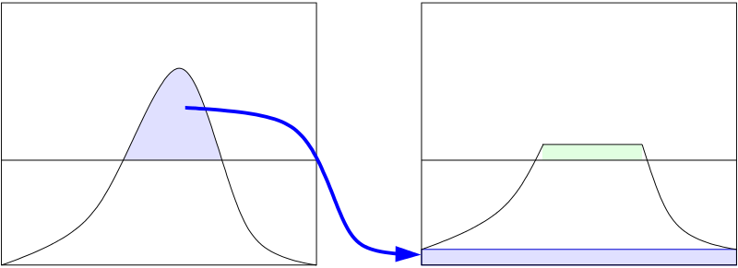
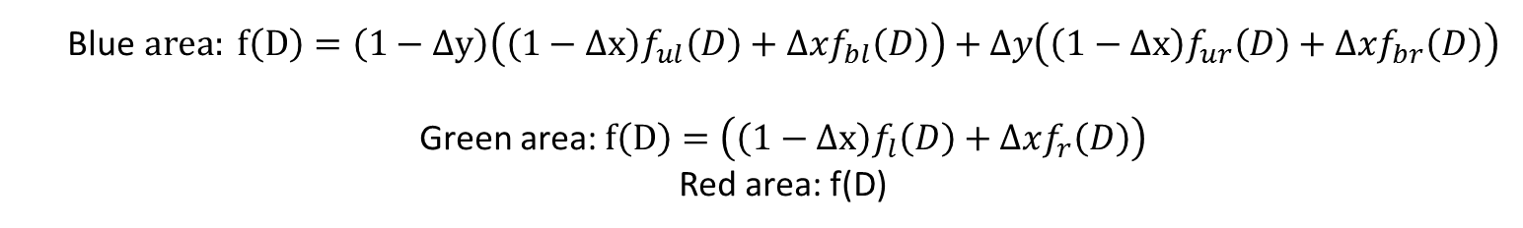
Method
CLAHE
Mirror padding
Blue$area: f\left(D\right)=\left(1−∆y\right)\left(\left(1−∆x\right)f_{ul}\left(D\right)+∆xf_{bl}\left(D\right)\right)+∆y\left(\left(1−∆x\right)f_{ur}\left(D\right)+∆xf_{br}\left(D\right)\right)$
Green area: $f\left(D\right)=\left(\left(1−∆x\right)f_{l}\left(D\right)+∆xf_{r}\left(D\right)\right)$
Red area: f(D)

Slide 5
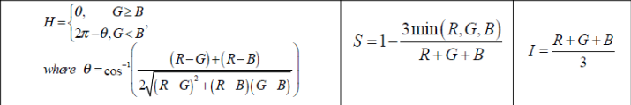
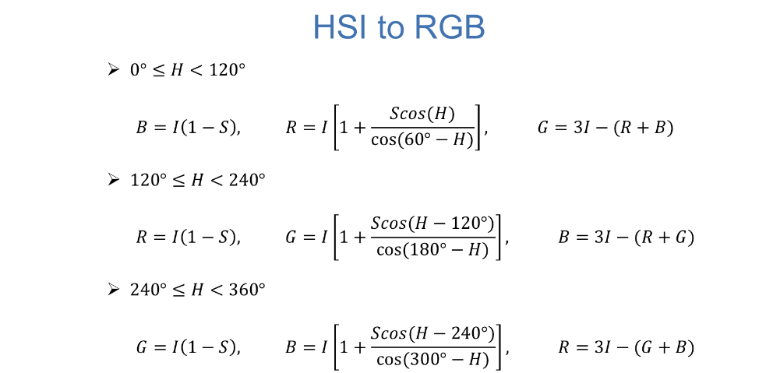
Method
HSI

Slide 6
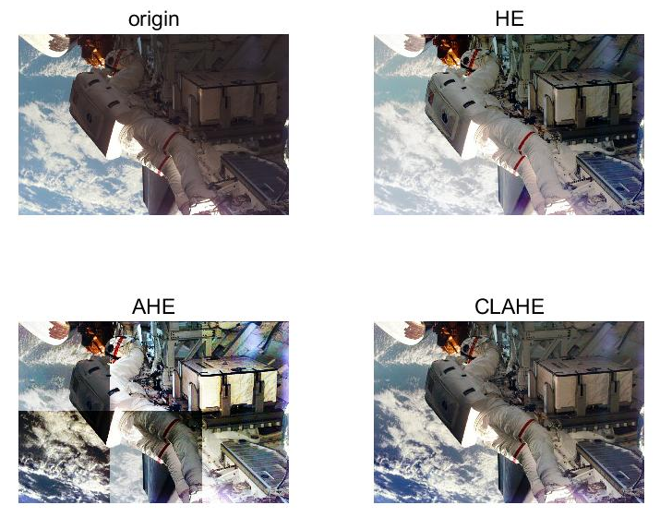
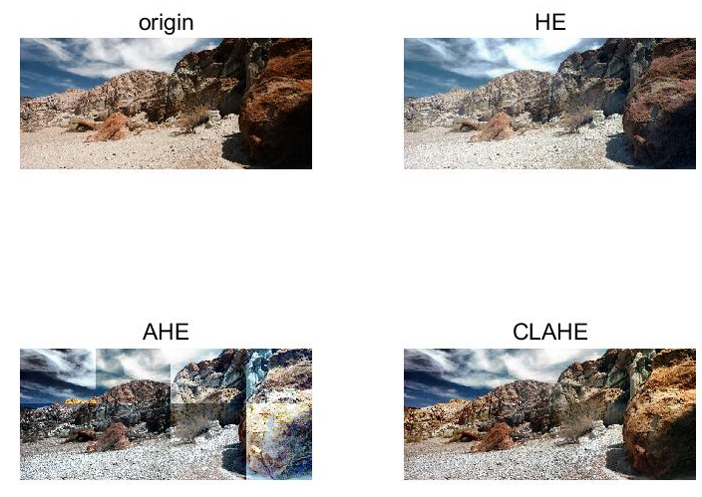
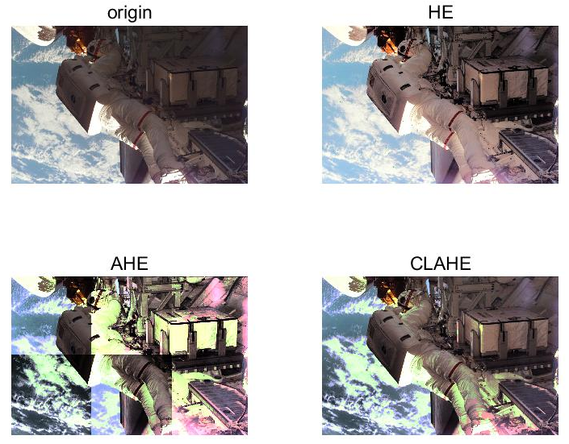
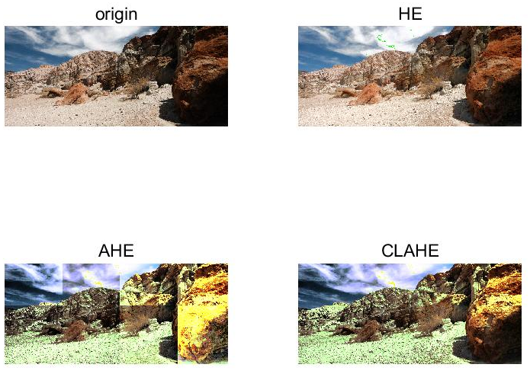
Result

Slide 7
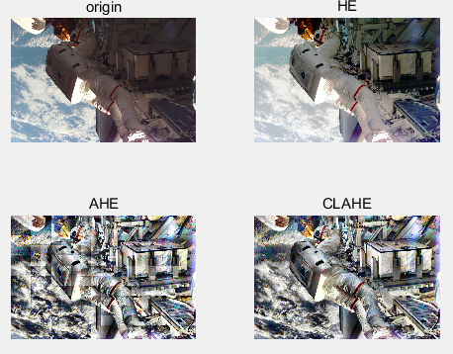
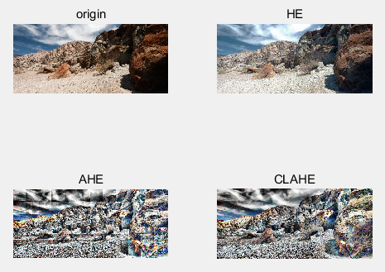
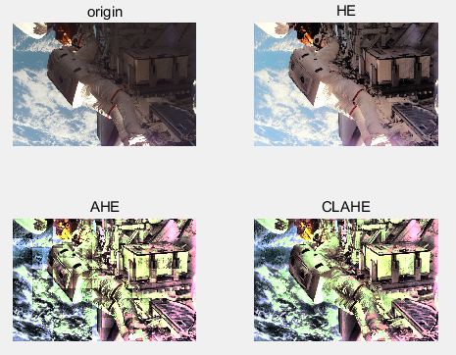
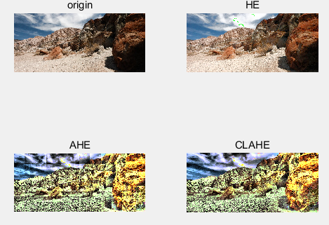
Result

Slide 8
Discussion
For HE, it is a histogram equalization of the image globally, so the image will generally increase the brightness. Because after the equalization, the dark places will be weakened.
AHE improve the local contrast and edge of the image to get more details. However, the problem of AHE is that while enhancing the contrast, it also amplifies the noise of the image. So it looks like there are a lot of borders.
When using CLAHE, because the interpolation method is used, the image will look smoother.
But for HE and AHE or CLAHE, HE improves brightness in the original dark part, but weaker than AHE and CLAHE. But in vision, I think HE looks better.
For RGB model and HSI model, different window sizes create different styles. In my opinion, HSI is better than RGB in certain aspects, like in vision, contrast. Maybe it has distortion.

